Slide 1
5 selfish reasons for reprodubility

Slide 2
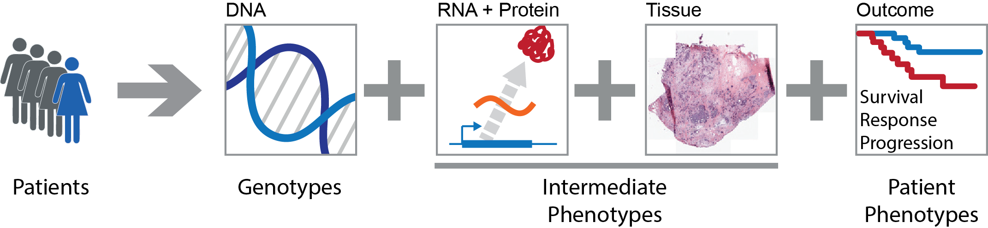
Systems Genetics of Cancer
Genetic variation
In people
In tumours
In clones
Phenotypic variation
Tumour subtypes
Aggressiveness
Survival

Slide 3
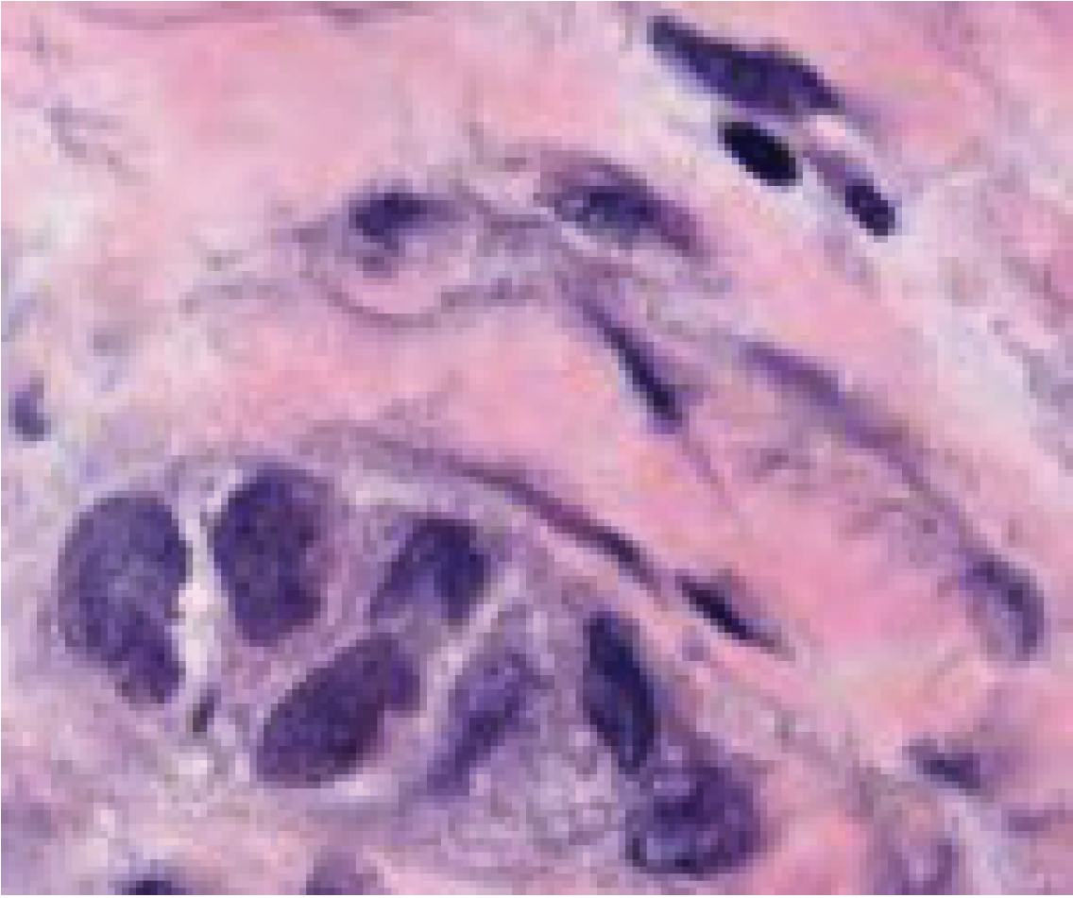


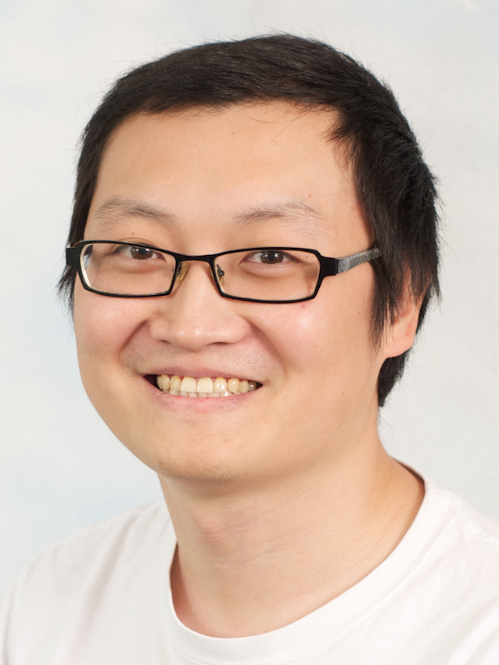
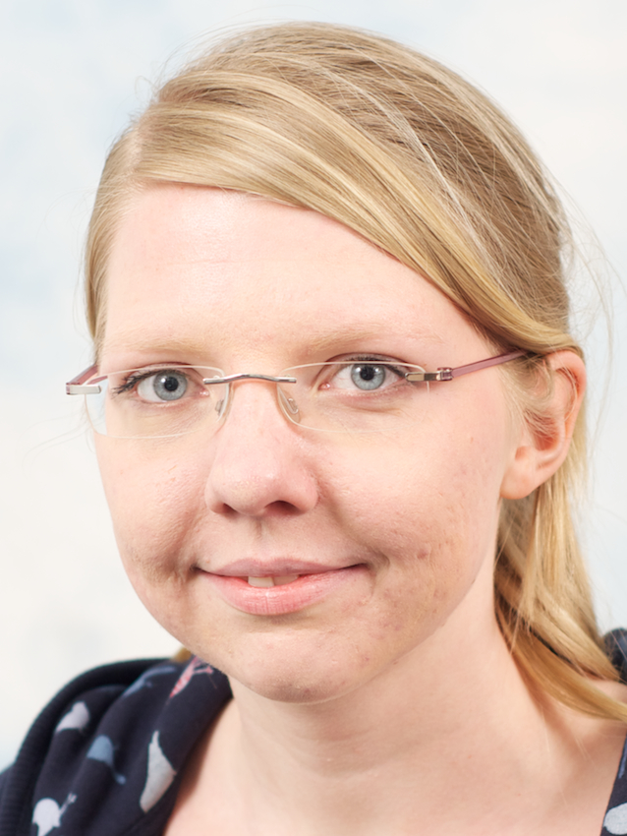
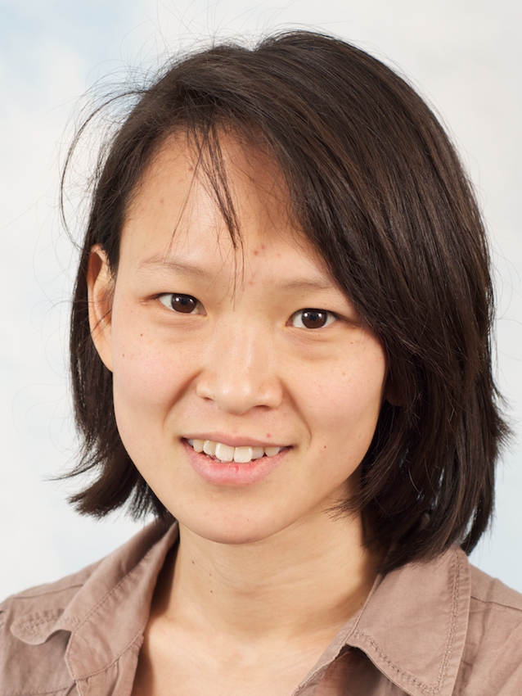





Cancer genome
Function
Cancer genome
Evolution
Cancer tissue
Context
Andy
Wei
Ke
Edith
Anne
Joe
Amanda
Ines
Geoff
Leon

Slide 4
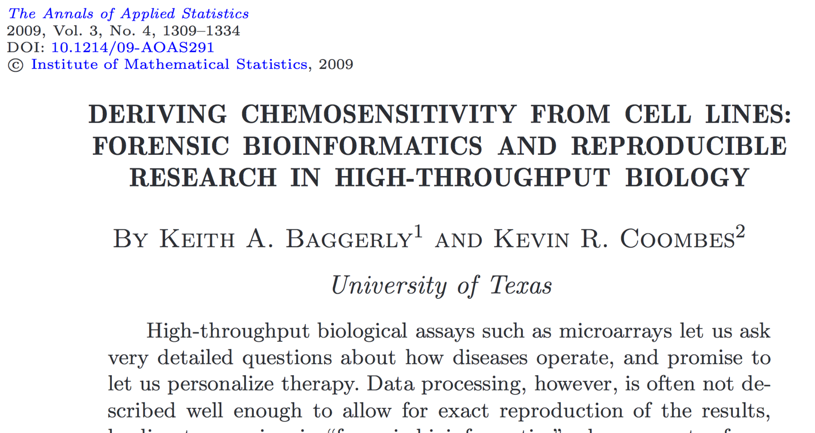

Slide 5
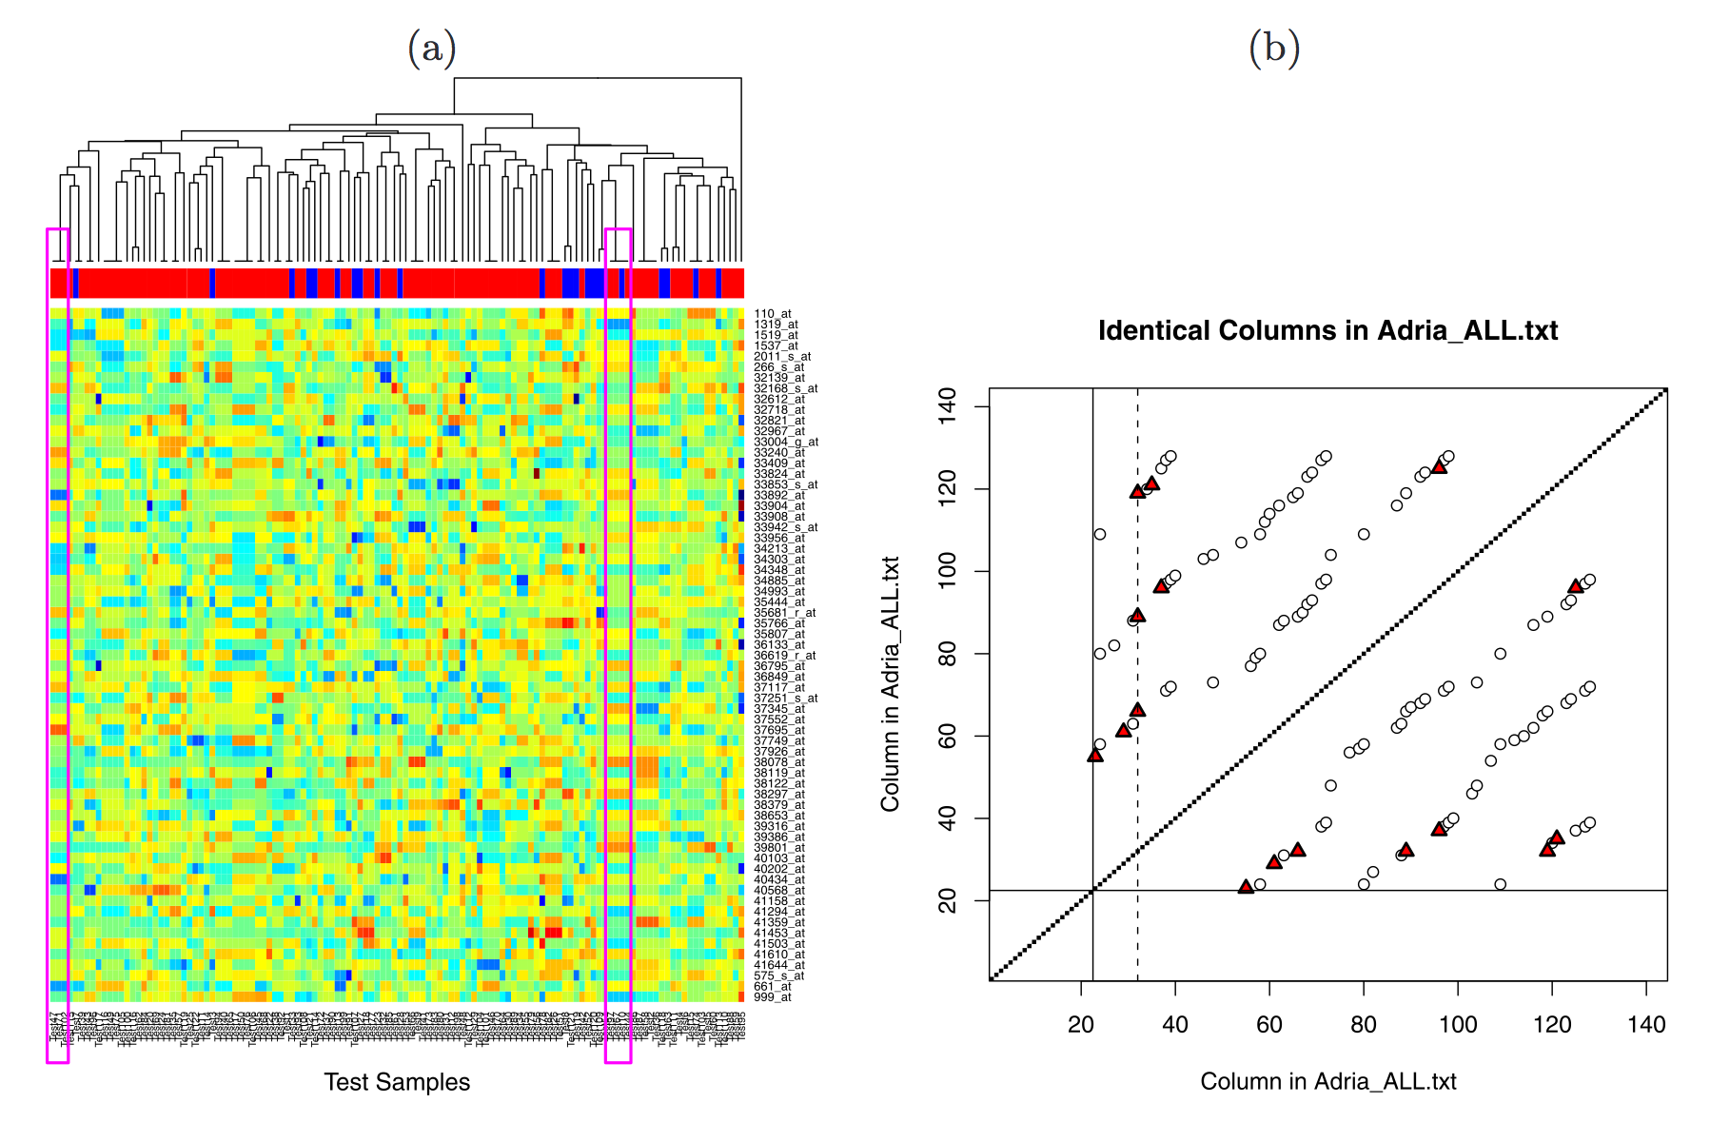

Slide 6
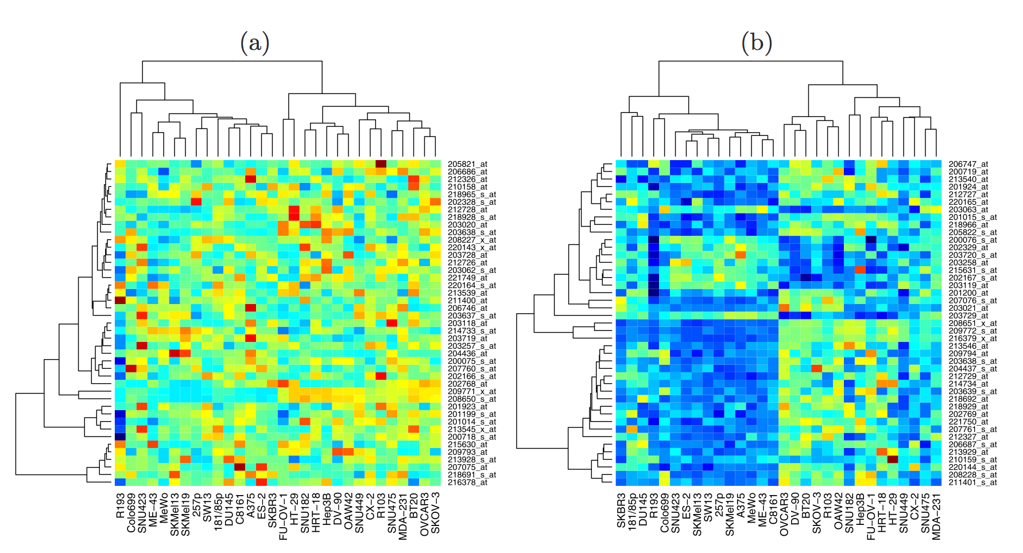

Slide 7
0

Slide 8

Too honourable for his time

Slide 9

It’s treason … only if we lose

Slide 10
1

Slide 11
Anatomy of the NFκB pathway
Step 1
?
Hits
Weak
Phenotype
Strong
NFκB
Step 2
Knock-down
Compare
expression
phenotypes
by NEMs
Known pathway
members
New RNAi Hits

Slide 12
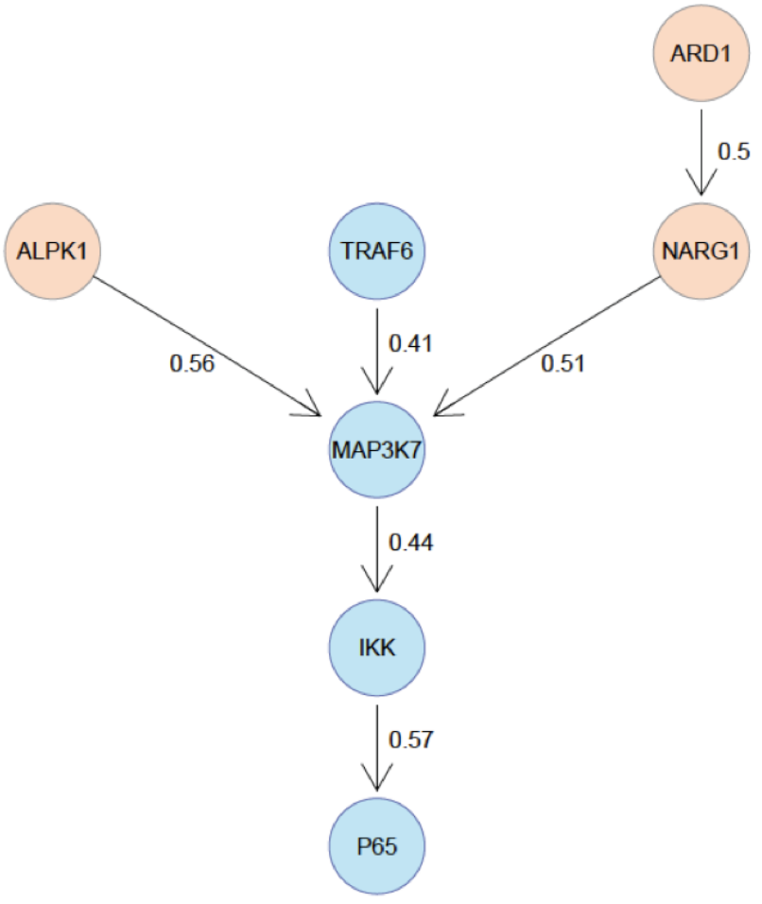
What a nice result!

Slide 13
2

Slide 14
3

Slide 15
4

Slide 16
5

Slide 17
Summary
0. This is how it’s done right
Avoid disaster
NFKB example
It is easier for me to engage
Example: grade
Continuity in the lab
Going back to your own code can be really tough, even tougher when continuing on others projects
Easier to argue with reviewers
PLoS Medicine example
Standing in the community

Slide 18
Excuses people make
You should do it, but the effort you put into should be valued by the group you work in and your supervisor.
It takes too long
It should be every postdocs business how to document their work
I can do all this in Excel

Slide 19
When do you need to worry about reproducibility?
Before you start the project
When you do the analysis
When you write the paper
When you co-author a paper
When you review a paper

Slide 20
If you have a new algorithm or method, mot people make their code available
BUT what I talk about are analysis scripts using ‘standard’ software.

Slide 21
Inferring cancer evolution
Thank you !

